Slide 1
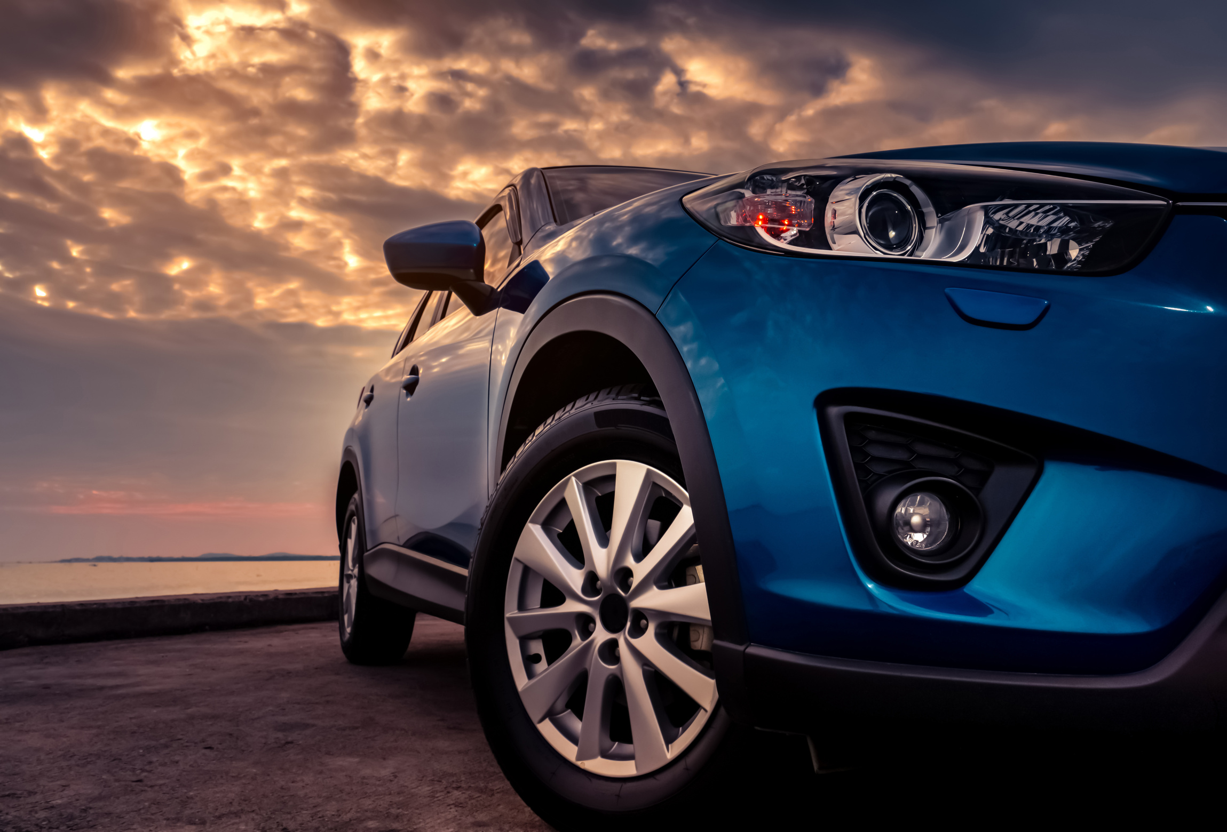




Drive Safety
Route Eye
Route Eye System
Project
Detection And Alert System For Drowsiness Drivers Using CNN Model Technology And IOT
2024

Slide 2


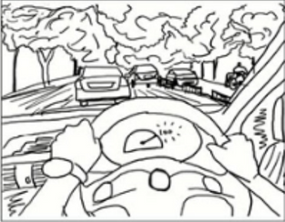
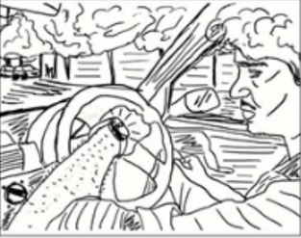
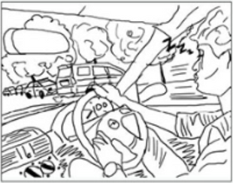
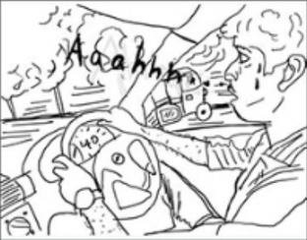
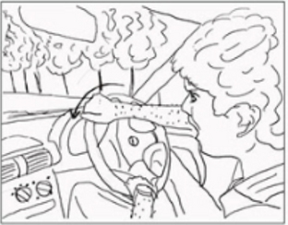
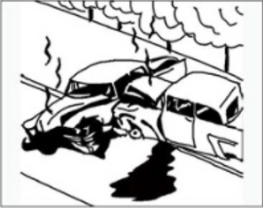
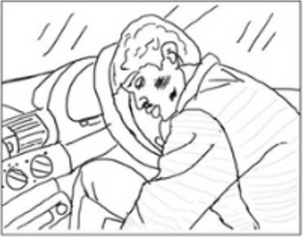
Bad Story
Drowsiness

Slide 3




Problem
1.35 Million
Road Traffic Deaths every year
1st
Road traffic injuries are
Leading cause of death
cause of death among children aged 5-14 and among young adults aged 15-29
8th
Every 24 Seconds Someone Dies On The Road

Slide 4
Problem Statement
Driver Drowsiness lead to accidents.
Existing solutions are often expensive or lack effectiveness.
Need for proactive accessible solutions for safer driving experiences.

Slide 5
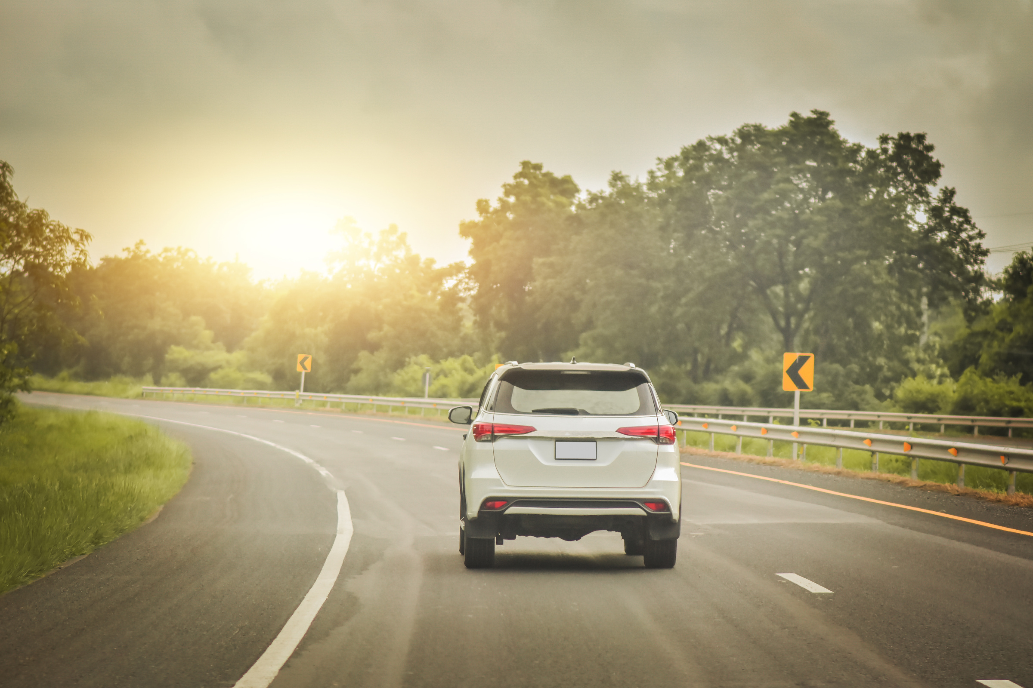
Our Mission
Driver Safety
Detect and prevent Drowsiness using advanced Deep Learning models and IOT technique for Alerts.

Slide 6


Our Solution

Slide 7
Solution Overview
The Route Eye System utilizes advanced deep learning algorithms and real-time image analysis to enhance driver safety by detecting driver drowsiness.
It operates through a user-friendly mobile app and leverages the device's camera to monitor the driver and surroundings.

Slide 8
Solution Overview
The app provides timely alerts to drivers, promoting awareness and preventing potential accidents.
The Route Eye System incorporates Internet of Things (IoT) technology and specialized hardware to enhance its alert system for driving safety.

Slide 9
Key Features
feature: Drowsiness Detection .
Graded alert system: LED light, sound Alert, seat vibration, App Notification.
Real-time monitoring for a safer driving experience.

Slide 10

How Route Eye System Works

Slide 11





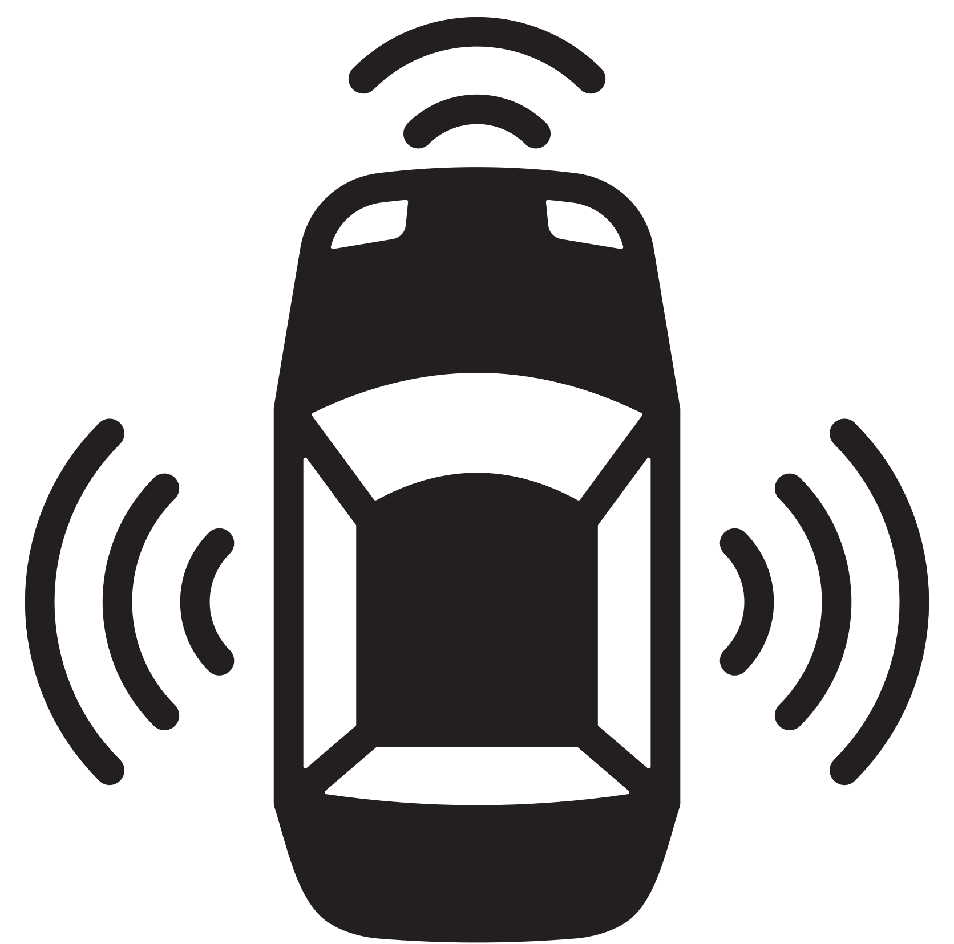
How It Works?
01
02
03
04
05
Driver mounts the mobile device on the car dashboard.
Mobile camera captures images every second.
Drowsiness Detection using deep learning models.
Multi-tiered alert system for timely notifications using IOT.
Take a one or more of user-defined Precautionary actions.

Slide 12
How It Works?
The system analyzes facial expressions, yawns, and eye closures to detect signs of drowsiness.
Deep learning algorithms identify specific patterns associated with drowsiness.
Real-time monitoring ensures timely detection to prevent accidents.

Slide 13
How It Works?
Real-time Alerts:
When drowsiness is detected, the system provides real-time alerts to the driver.
Alerts promptly notify the driver of drowsiness and potential collision risks.
This multi-tiered approach ensures that alerts are noticeable and effective in alerting the driver.

Slide 14






How It Works?
Real-time Alerts:
Alerts are delivered through a graded system that includes visual cues, sound alert, and vibrations for drowsiness detection.
01
02
03
04
Sound
LED
Vibration
Notification

Slide 15
How It Works?
User-defined Precautionary actions
User can choose / define some Precautionary actions that the system can take if the system alerts failed to wakeup the driver such as :
Change to auto drive system
Using Smart car parking system
Contact one of the driver relatives

Slide 16
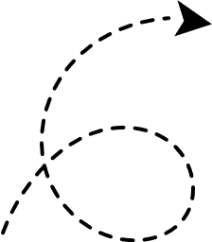

Technology Used
Tools Used
AI
Tensorflow
IOT
Flask
Mobile APP
Flutter

Slide 17
Technology Background
To enhance model performance: we systematically explore and experiment with diverse machine learning or deep learning models, as Transfer learning using VGG19 .
Ultimately, the best results are achieved through the CNN model

Slide 18
Technology Background
Drowsiness Detection :
we use Convolutional Neural Network (CNN) model
Training Data: Closed eye, Open eye, Yawn ,No-yawn
The Camera of the app is used to capture images that serve as input for the drowsiness prediction process.
Images are taken by a timer that triggers every 1000 milliseconds (1 seconds).

Slide 19
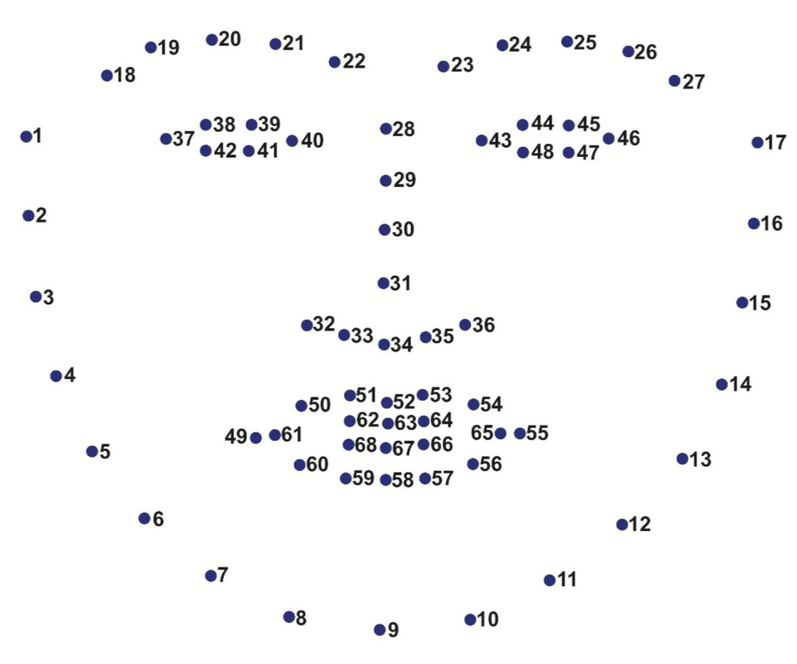
Technology Background
Drowsiness Detection :
We use dlib library that provides tools and algorithms for machine learning, computer vision, and image processing tasks.

Slide 20
Technology Background
Drowsiness Detection :
We use dlib library that provides tools and algorithms for machine learning, computer vision, and image processing tasks.
It presents a method that precisely estimates the positions of facial landmarks using a training set of labeled facial landmarks on images.

Slide 21
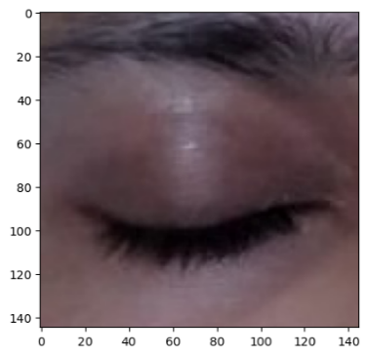
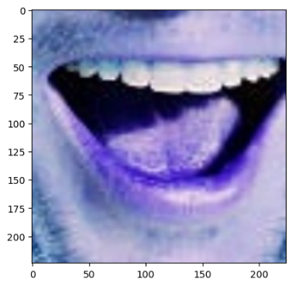
Technology Background
Drowsiness Detection :
The model is capable of analyze the cropped eye and mouth regions to predict the likelihood of drowsiness.

Slide 22
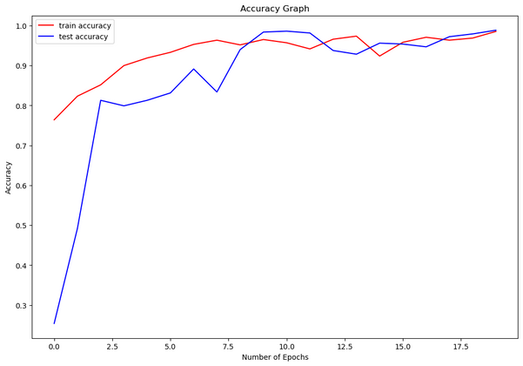
Technology Background
Drowsiness Detection
We achieved up to 98% accuracy for the drowsiness model
View a graph of model accuracy

Slide 23
Technology Background
Integration in Flutter:
Framework: Flutter is used for developing the mobile application.
Frontend: The Flutter framework facilitates the creation of a user-friendly interface for the driver.
Backend: The trained CNN models are integrated into the application's backend to perform real-time image analysis.

Slide 24
Technology Background
Integration in Flutter:
Real-time Image Capture: The front camera of the mobile device captures images at regular intervals.
Inference Engine: The captured images are processed through the respective CNN models for drowsiness detection, distraction detection, and route analysis.

Slide 25
Technology Background
Alert System:
Based on the predictions from the three features, a multi-tiered alert system is implemented using Hardware to notify the driver of potential dangers.
Alerts escalate gradually, employing visual signals, auditory alerts, and tactile feedback to ensure the driver's attention is captured effectively.
This technical setup, utilizing CNN models for each feature, and implementing them within a Flutter-based mobile application, aims to provide a robust solution for enhancing driver safety.

Slide 26
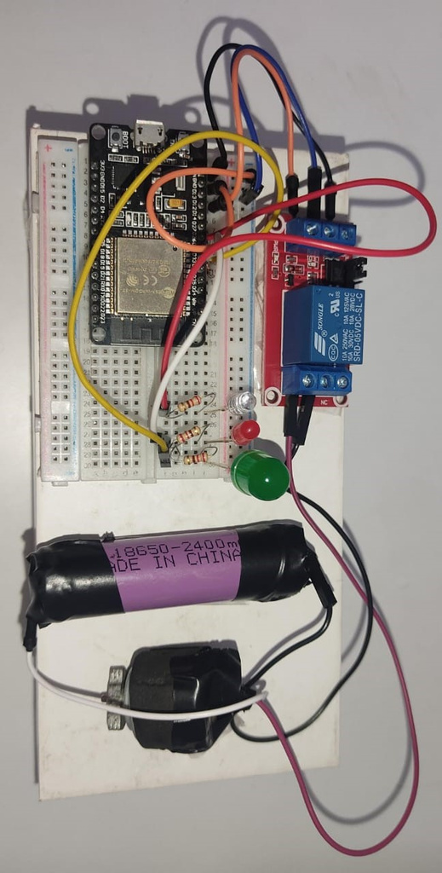
Technology Background
Alert System:
The fundamental concept revolves around the ESP32 monitoring a value from the Firebase Realtime Database, which is stored in a variable named "level," denoting the instances when the driver is detected as drowsy.

Slide 27

Competitive Analysis

Slide 28


Competitive Analysis
Features
Valeo
verizon telematics
guardian fleet
Smart eye
Route Eye
Cost effect
Mobile app
levels of alert
Facial expression analysis
object detection
Drowsiness

Slide 29

Competitive Advantages
Analyzing the driver's face to detect drowsiness.
Cost-Effective Mobile App.
Multi-tiered Alert System for effective communication and prompt response.

Slide 30

Business Model

Slide 31
01
02
04
05
07
Key Partners
Key Activities
Value Proportions
Customer Relationships
Customer Segments
Develop ML models to detect drowsiness and send alert levels to the driver
initiates a graded alert levels system
Enhanced Safety and Accident Prevention.
insurance providers.
Seamless Integration and User-Friendly Design
Self services
(Feedback,
Review,Rating)
App Support,
App Analytics
Individuals
Taxi Drivers
driving schools
Drowsiness Prevention for Focused Driving:
Real-time Alerts for Proactive Intervention
06
Long-Distance Truck Drivers.
Parents distracted by children
Automotive Manufacturers:
Government transportation sector
Channels
Transportation and shipping companies
03
Advanced Drowsiness Detection
Individuals
Cost-Effective and Versatile Solution
Key Resources
Social Media Advertising
Mobile App
ML Engineers
App developer
Hardware
08
Cost Structure
09
Revenue Streams
Mobile app development
Cloud hosting
Marketing
Server maintance
Hardware
subscription
partnership and collaboration
collaborate with driving schools
data analytics services

Slide 32

Market Opportunity
The global market for driver safety solutions is growing rapidly.
Increasing awareness and regulations related to driver safety create a favorable market environment.
Our solution addresses a critical need in the market for accurate drowsiness detection.
Eye Route has the potential for widespread adoption among individual drivers, fleet operators, and ridesharing services.

Slide 33
How can the Route Eye System help develop Egypt's Vision 2030 ?

Slide 34



Improving Transportation Efficiency
Reduction in Traffic Accidents
Enhancing Road Safety
Adoption of Advanced Technologies
International Collaboration and Partnerships
Digital Transformation and Innovation

Slide 35
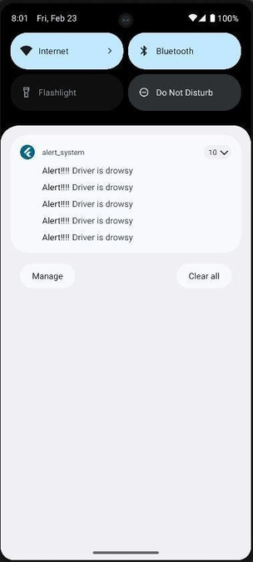
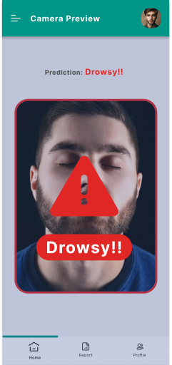
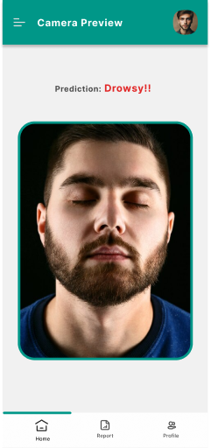

ROUTE EYE
APPLICATION
The camera preview that provide real time detection, Start detection drowsy state then app in , Then send Alerts to the driver to attention,
Notification sent to those following the driver when a state of drowsiness is detected.

Slide 36

Our Team Members
Mariam Al-hussiny
Youssef Khalil
Mariam Ahmad
Nawal Abdelkalek
Yousef Ibrahim
Mariam Osama

Slide 37
Thank you
I really appreciate your time.

